Slide 1
Analyzing system logs, operating system updates
UNIT - 5

Slide 2
1. Analyzing system logs
(1) The system log file contains events that are logged by the operating system components.
System log files may contain information about device changes, device drivers, system changes, events, operations etc.
Example:
Web servers maintain log files listing every request made to the server.
With log file analysis tools, it's possible to get a good idea of where visitors are coming from, how often they return, and how they navigate through a site.
Using cookies enables Webmasters to log even more detailed information about how individual users are accessing a site.
(2) Application logs – generated by users
(3) Data logs(scientific experimental data) – light intensities, temperatures and sound frequencies

Slide 3
Analyzing system logs
Search. Diagnose. Report.
Log data is a definitive record of what's happening in every business, organization or agency and it’s often an important resource when it comes to troubleshooting and supporting broader business objectives.
Splunk - provides the industry-leading software to consolidate and index any log and machine data, including structured, unstructured and complex multi-line application logs.
we can collect, store, index, search, correlate, visualize, analyze and report on any machine-generated data to identify and resolve operational and security issues in a faster, repeatable and more affordable way.
It's an enterprise ready, fully integrated solution for log management data collection, storage and visualization.
queries and reporting across historical data can also be accomplished without third-party reporting software.
Notes:
Ad hoc

Slide 4
Analyzing system logs
Splunk software supports log data enrichment by providing flexible access to relational databases, field delimited data in comma-separated value (.CSV) files or to other enterprise data stores such as Hadoop or NoSQL.
Splunk software supports a wide range of log management use cases including log consolidation and retention, security, IT operations troubleshooting, application troubleshooting and compliance reporting.
Index, search and correlate any data for complete insight across your infrastructure
Turn searches into real-time alerts, reports with a few mouse clicks
Securely make operational data available without requiring access to production systems
Scale from a single server to global datacenters
Deploy and search across on-premise, hybrid-cloud and private/public-cloud based installations

Slide 5
Example
Roles of EventLog Analyzer - Server Monitoring and Management Software
Monitors and detects server activities continuously
Examines and alerts the administrator on potential threats and issues for troubleshooting; before a server mishap occurs
Records server logs and reports for easy tracking of errors, if already caused
Performs log analysis on various OS: Windows, Linux, Solaris, and other UNIX systems
Monitors server performance 24/7
Assists in planning on server capacity expansion

Slide 6
Example - GUI tool to view log files on Linux
System Log Viewer is a graphical, menu-driven viewer that you can use to view and monitor your system logs. You can start System Log Viewer in the following way:
Click on System menu > Choose Administration > System Log:
/var/log/messages
/var/log/boot.log
/var/log/auth.log

Slide 7
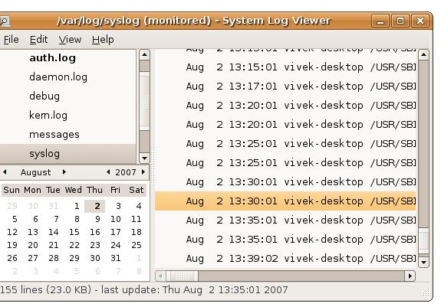
Example - GUI tool to view log files on Linux

Slide 8
2. Operating system updates
An operating system is the core set of programs that run a computer and upon which all other programs rely in order to operate.
Operating system updates are corrections for program incompatibilities, discovered errors, and security vulnerabilities.
There are errors and security problems discovered in every operating system and updates are created and distributed on a regular basis.

Slide 9
Need of operating system updates
Operating system updates often address security vulnerabilities
If operating system updates are not installed in a timely manner it can lead to unauthorized access, theft of personal, confidential, or protected information or the destruction of data.
use of automatic operating system updates help to prevent these types of problems and to meet the minimum security requirements.
For those systems where automatic operating system updates are not available a plan should be put in place which
1) identifies which systems are not automatically updated,
2) states which resource(s) will be used to determine if an operating system update is available, and
3) directs how and by whom the update will be installed.

